Slide 1
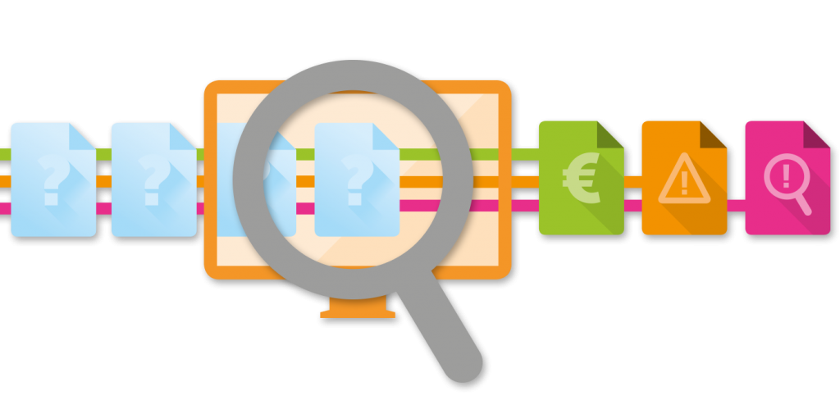
CIS 5560
Professor J. Woo
PREDICTING AD CLICK FRAUD
MACHINE LEARNING PREDICTIVE ANALYSIS USING AZURE ML AND DATABRICKS SPARK ML
Group- F
Hai Anh Le
Neha Gupta
Maria Boldina

Slide 2
TABLE OF CONTENTS
Introduction
Dataset details
Technical specifications
Data processing and constrains
Selecting algorithms and performance metrics
Azure ML algorithms
Databricks Spark ML algorithms
Azure ML and Spark ML Results comparison

Slide 3
INTRODUCTION
Click Fraud happens at an overwhelming volume, resulting in misleading click data and wasted money
Click Fraud occurs when a person, automated script or computer program imitates a legitimate user, clicking on an ad without having an actual interest in the target of the ad's link
As the largest mobile market in the world, China suffers from huge volumes of fraudulent traffic
TalkingData is China’s largest independent big data service platform
covers over 70% of active mobile devices nationwide
handles 3 billion clicks per day
90% of which are potentially fraudulent
The goal of our project is to predict whether a user will download
an app after clicking on a mobile app ad
To better target the audience, to avoid fraudulent practices and save money

Slide 4

DATASET DETAILS
Dataset name: TalkingData AdTracking Fraud Detection
Dataset URL: https://www.kaggle.com/c/talkingdata-adtracking-fraud- detection/data
Dataset contains 200 million clicks over 4 day period
Dataset size:
Original dataset size: 7GB
Implemented Python code to reduce size to1GB (15%)
Dataset format: .csv

Slide 5
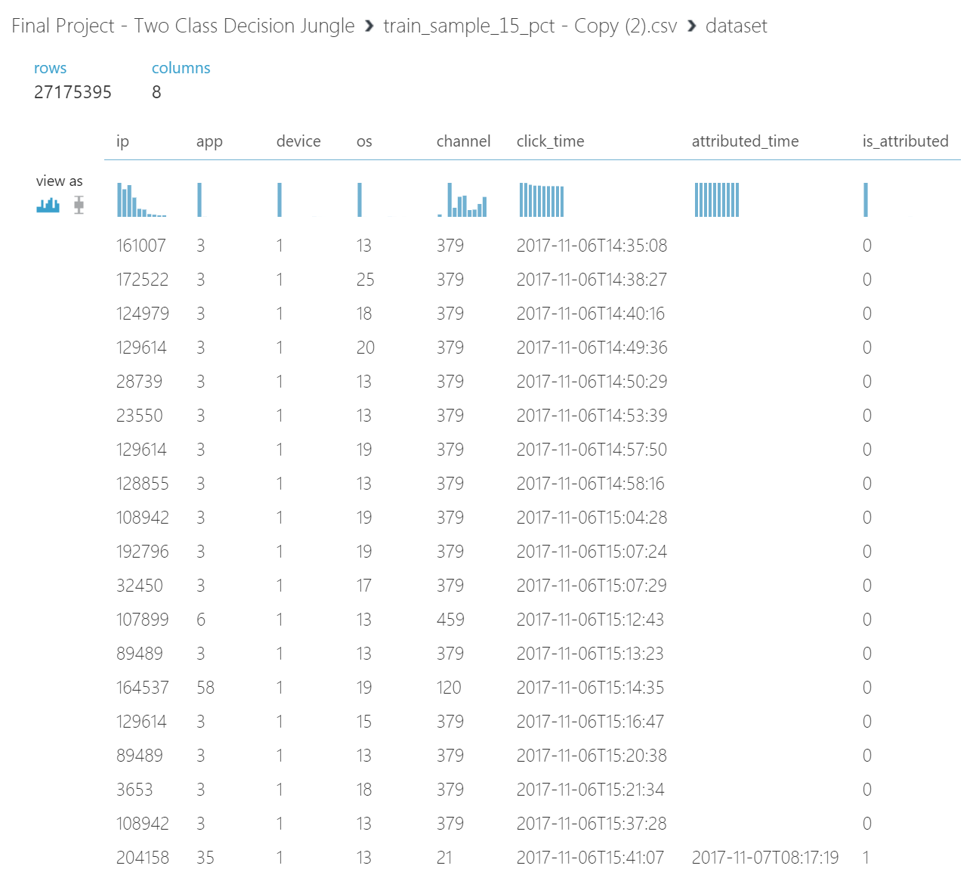
DATASET DETAILS

Slide 6
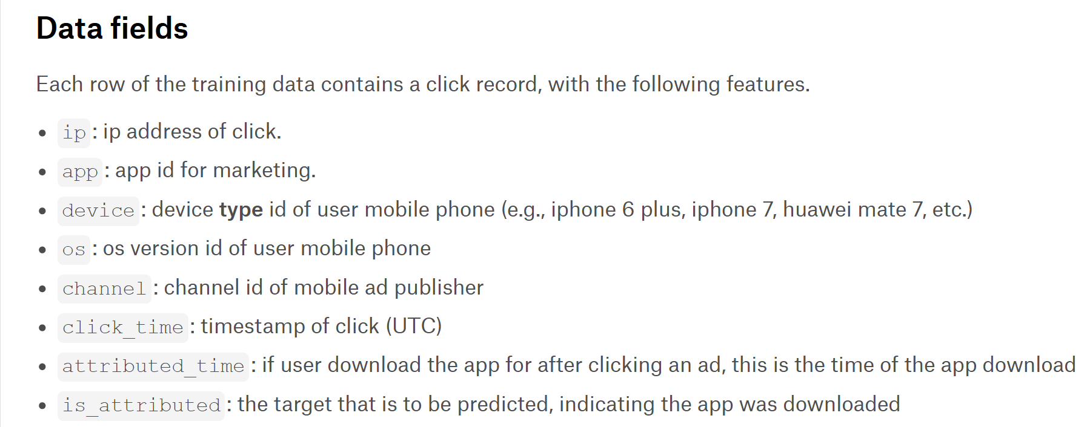
DATASET DETAILS
Features
Label

Slide 7

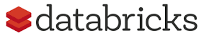
TECHNICAL SPECIFICATIONS
Azure ML Studio
Free Workspace
10GB storage
Single node
Region: South Central US
DataBricks Subscription
Cluster 4.0 (includes Apache Spark 2.3.0, Scala 2.11)
2 Spark Workers with total of 16 GB Memory and 4 Cores
Python 2.7

Slide 8
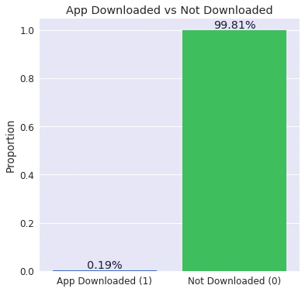
DATA PROCESSING AND CONSTRAINTS
Unbalanced dataset with number of negative classes (0) far more outweighing the positive class (1)
0.19% App downloaded
99.81% App not downloaded
1GB dataset still too large for Azure ML ➔ sampling was used

Slide 9
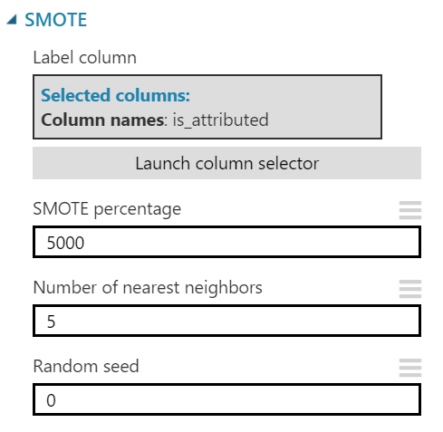
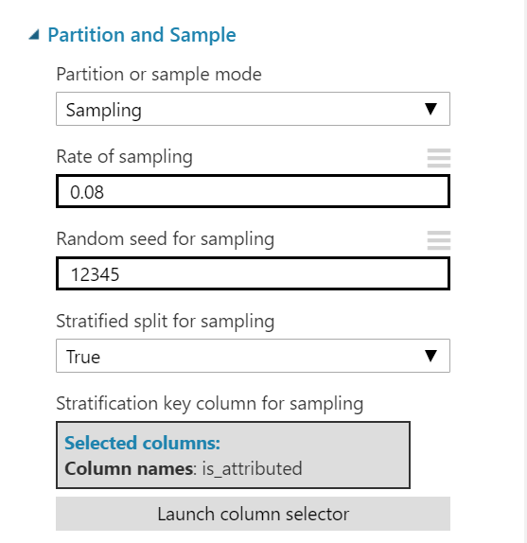
WORKING WITH UNBALANCED DATA
SMOTE: Synthetic Minority Over Sampling Technique takes a subset of data from the minority class and creates new synthetic similar instances
Helps balance data & avoid overfitting
Increased percent of minority class (1) from 0.19% to 11%
Stratified Split ensures that the output dataset contains a representative sample of the values in the selected column
Ensures that the random sample does not contain all rows with just 0s
8% sample used = 80 MB

Slide 10
SELECTING ALGORITHMS FOR AZURE ML
Two-Class Classification:
Binary or binomial classification is the task of classifying the elements of a given set into two groups
predicting a category or class, either downloaded (1) or not downloaded (0)
Decision trees often perform well on imbalanced datasets because their hierarchical structure allows them to learn signals from both classes.
Tree ensembles almost always outperform singular decision trees ➔
Algorithm #1: Two-class Decision Jungle
Algorithm #2: Two-class Decision Forest

Slide 11
SELECTING PERFORMANCE METRICS
 |  | CLASS DISTRIBUTION
 |  | EVEN | UNEVEN
COST | FN Cost More | Recall | Recall
 | Same Cost | Accuracy or F1 Score | F1 Score
 | FP Cost More | Precision | Precision
Precision
False Positives indicate the model predicted an app was downloaded when in fact it wasn’t
We want to minimize the FP ➔ save $$$
Notes:
True Positives are how often the model correctly predicted an app was downloaded
False Positives indicate the model predicted an app was downloaded when in fact it was not downloaded
True Negatives indicate how often the model correctly predicted an app was not downloaded
False Negatives indicate the model predicted an app was not downloaded when in fact it was downloaded

Slide 12
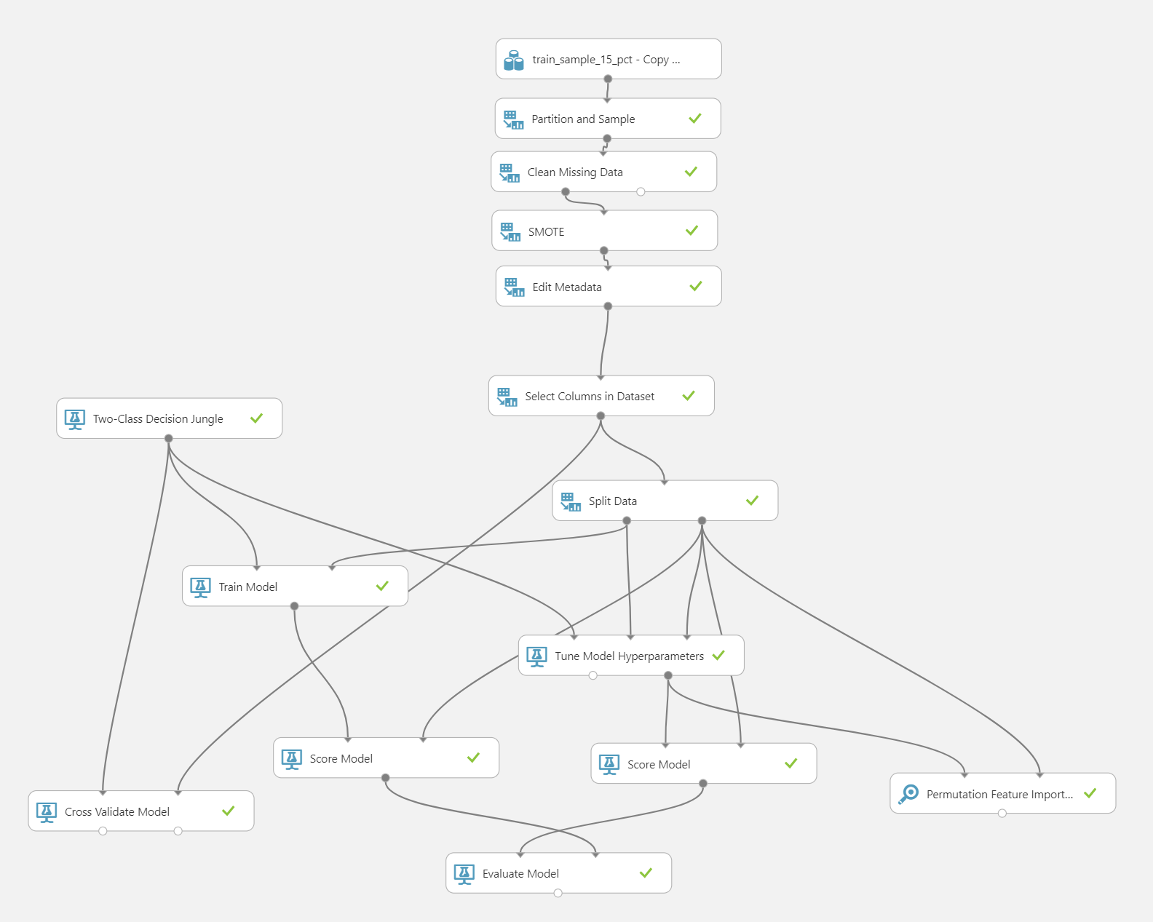
AZURE ML MODEL #1: TWO-CLASS DECISION JUNGLE
8% Sample
SMOTE 5000%
70:30 Split Train/Test
Cross-Validation
Tune Model Hyperparameters
Features used: all 7

Slide 13
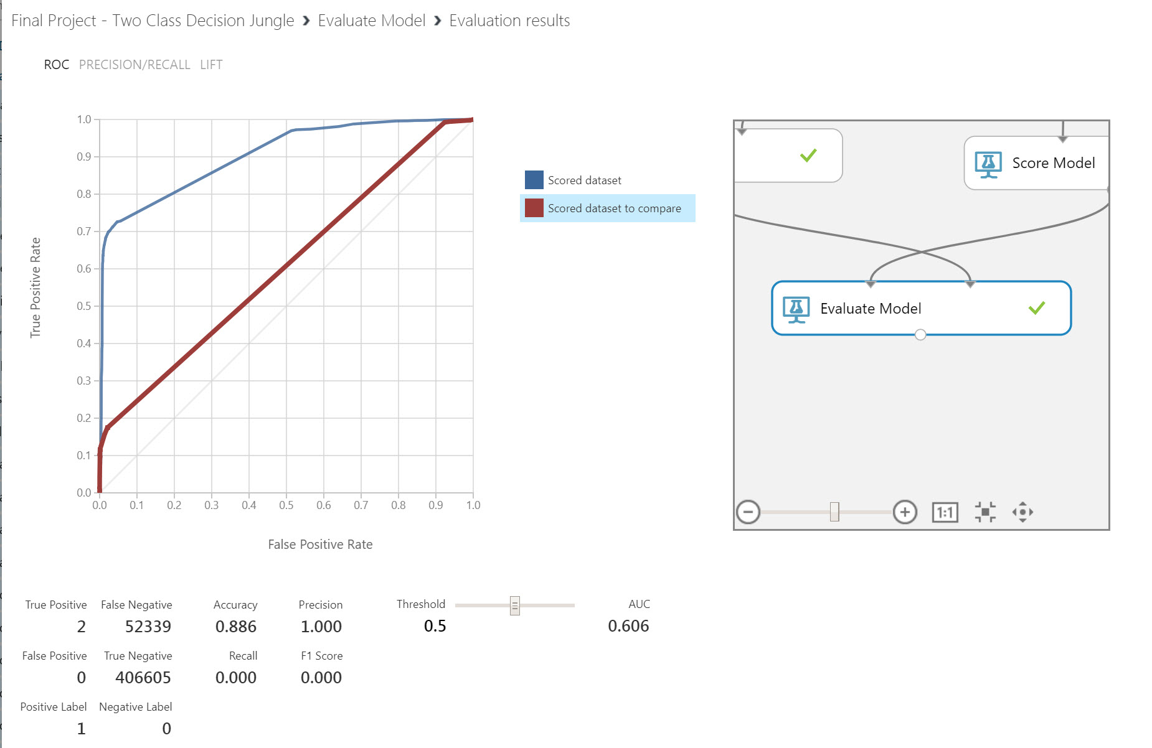
AZURE ML MODEL #1: RESULTS
AUC = 0.606

Slide 14
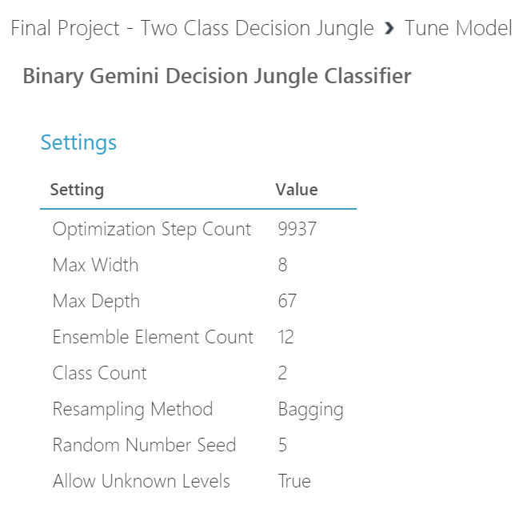
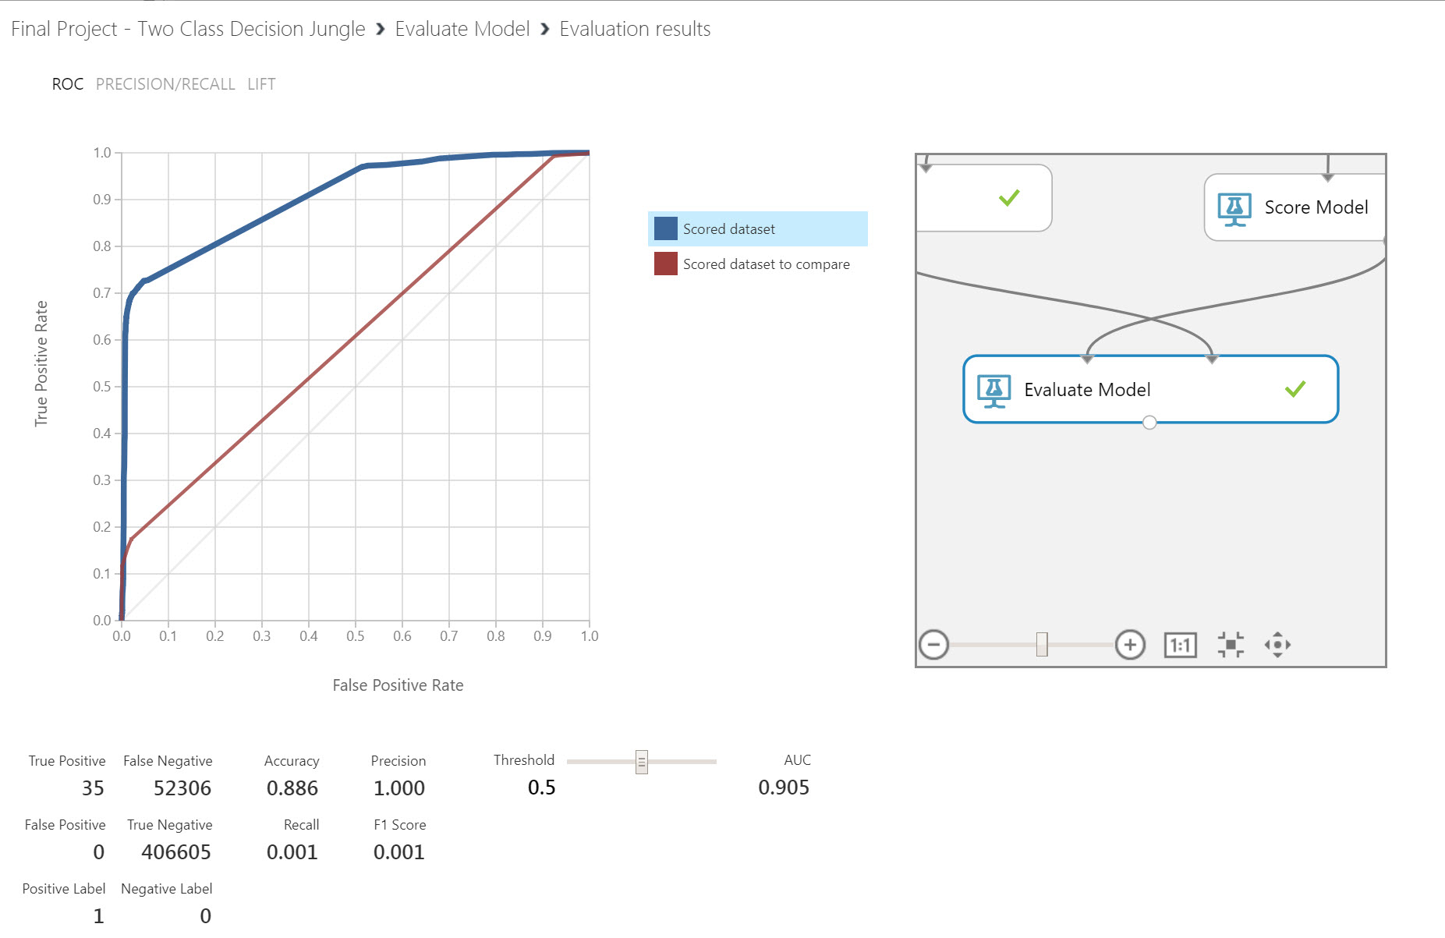
AZURE ML MODEL #1: Tune Model Hyperparameters
With Tune Hyperparameters
Without Tune Hyperparameters
AUC = 0.905 vs 0.606
Precision = 1.0
TP = 35, FP = 0

Slide 15
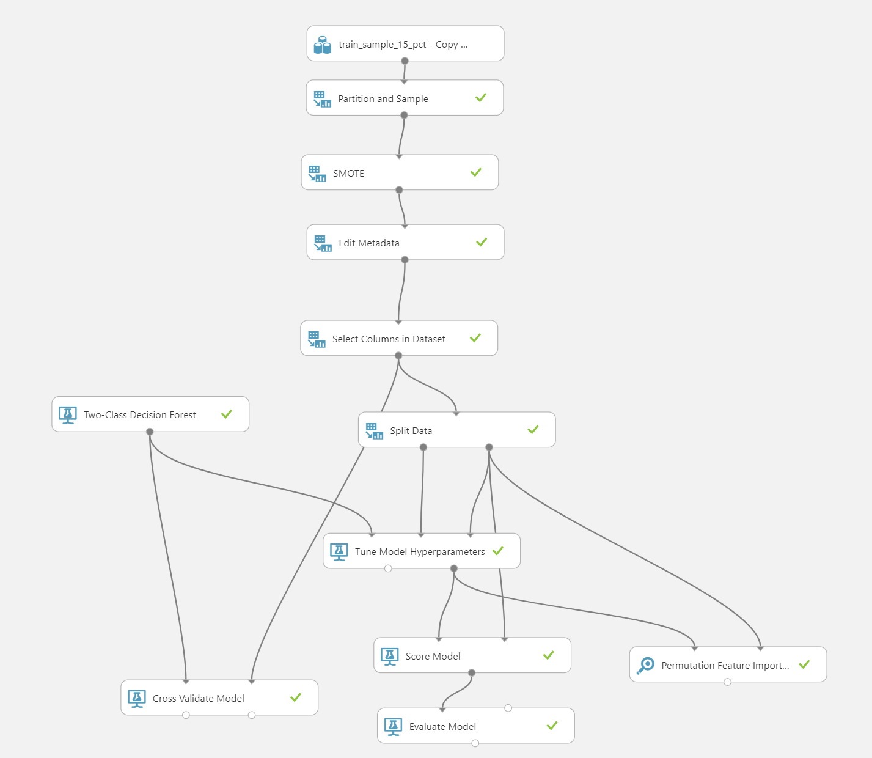
AZURE ML MODEL #2: TWO-CLASS DECISION FOREST
8% Sample
SMOTE 5000%
70:30 Split Train/Test
Cross-Validation
Tune Model Hyperparameters
Permutation Feature Importance

Slide 16
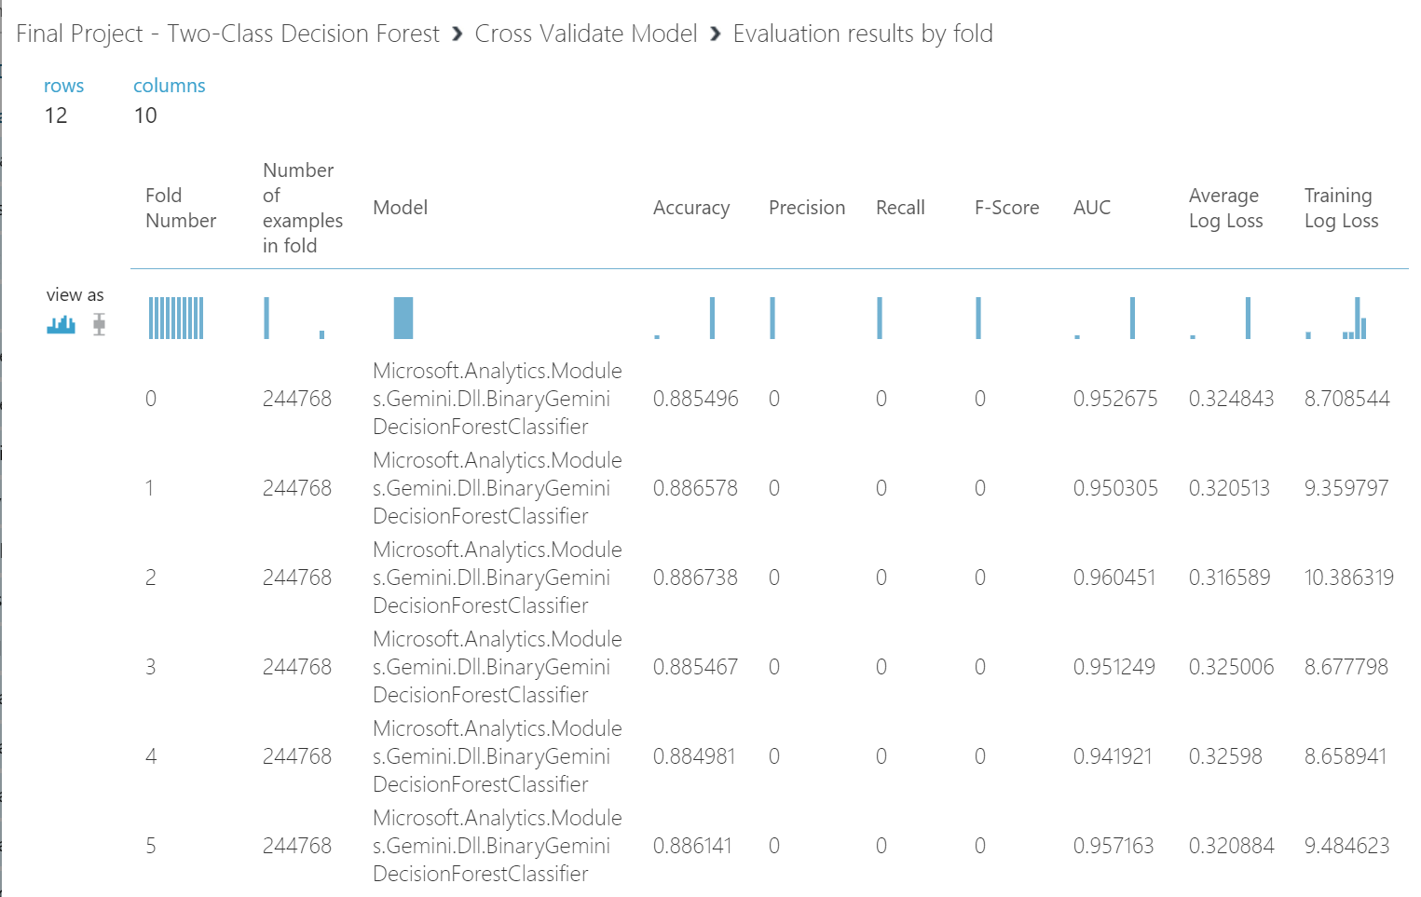
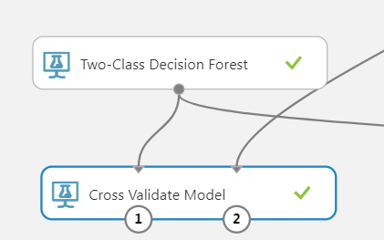
AZURE ML MODEL #2: Cross Validation

Slide 17
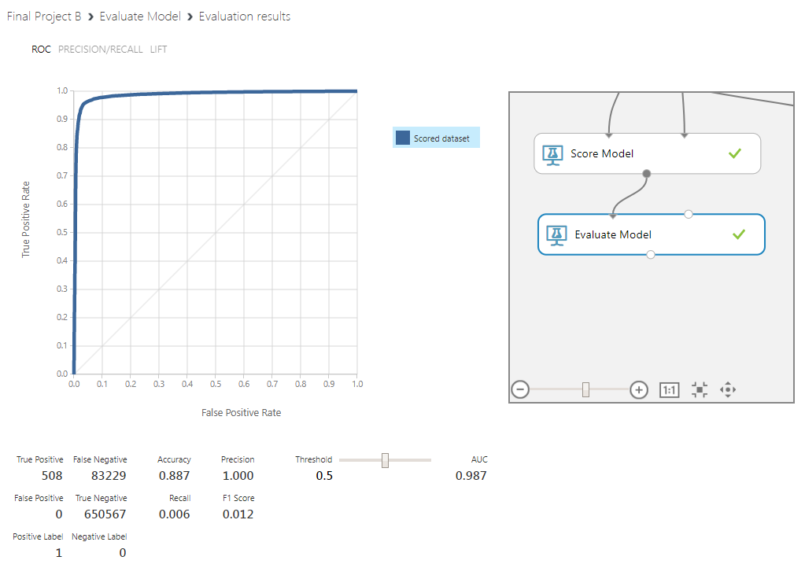
AZURE ML MODEL #2: RESULTS
AUC = 0.987
Precision = 1.0
TP = 508, FP = 0

Slide 18
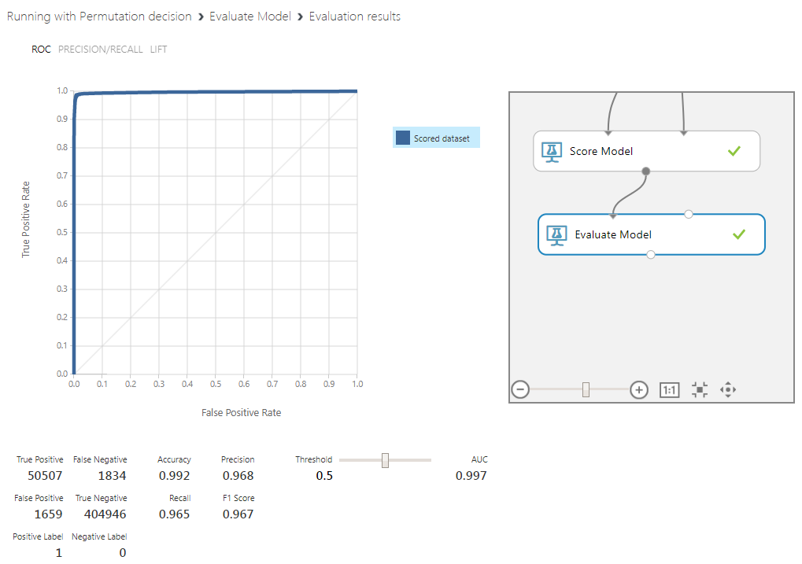
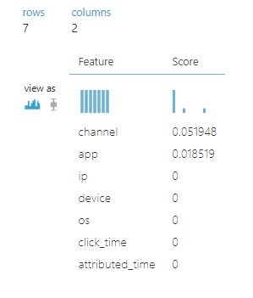
AZURE ML MODEL #2: Permutation Feature Importance
Features used:
channel
app
AUC = 0.997 vs 0.987
Precision = 0.968 vs 1.0

Slide 19
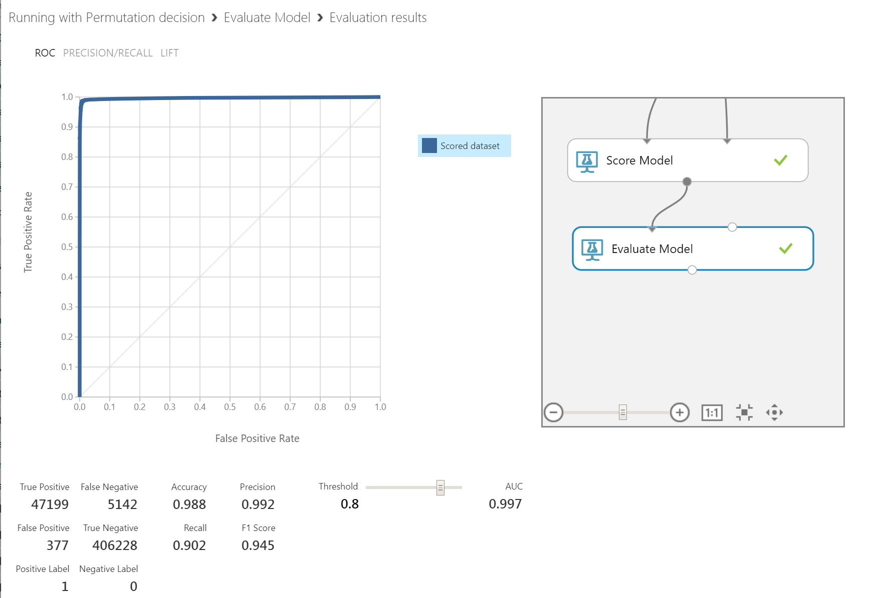
AZURE ML MODEL #2: Improving Precision
Precision increased to 0.992
FP decreased from 1,659 to 377
FN increased from 1,834 to 5,142
By increasing threshold from 0.5 to 0.8

Slide 20
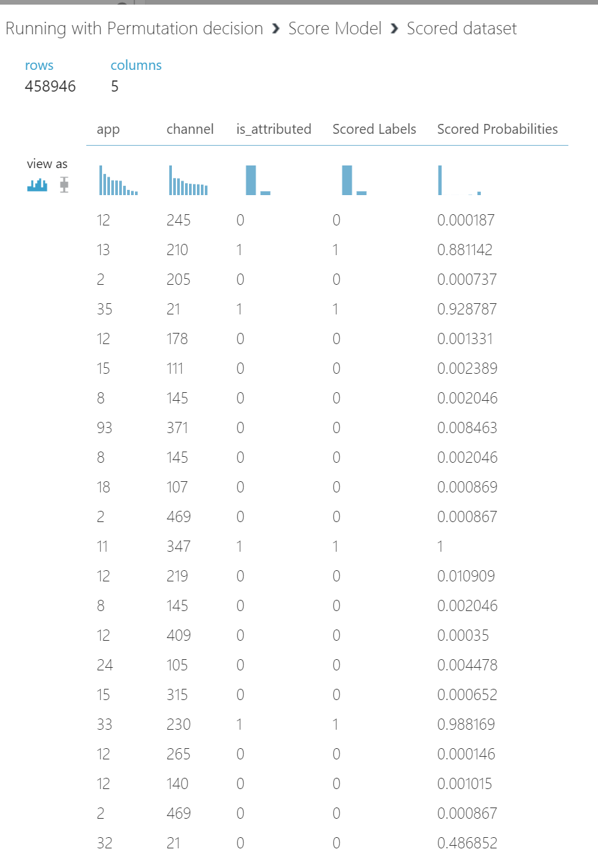
Permutation Feature Importance Results

Slide 21
AZURE ML RESULTS COMPARISON
 | TWO-CLASS DECISION JUNGLE | TWO-CLASS DECISION FOREST
AUC | 0.905 | 0.997
PRECISION | 1.0 | 0.992
RECALL | 0.001 | 0.902
TP | 35 | 47,199
FP | 0 | 377
TN | 52,306 | 406,228
FN | 406,605 | 5,142
Two-class Decision Forest is the best model!

Slide 22
SELECTING ALGORITHMS FOR DATABRICKS SPARK ML
Binary Classification:
Predicting a category or class, either downloaded (1) or not downloaded (0)
Binary or binomial classification is the task of classifying the elements of a given set into two groups (predicting which group each one belongs to) on the basis of a classification rule.
Algorithm #1: Decision Tree Classifier
Algorithm #2: Random Forest Classifier

Slide 23
DATABRICKS SPARK ML COMBINATION OF FEATURES
Feature 1: extract day of the week and hour of the day from the click time
Feature 2: group clicks by combination of (Ip, Day_of_week_number and Hour)
Feature 3: group clicks by combination of (Ip, App, Operating System, Day_of_week_number and Hour)
Feature 4: group clicks by combination of (App, Day_of_week_number and Hour)
Feature 5: group clicks by combination of (Ip, App, Device and Operating System)
Feature 6: group clicks by combination of (Ip, Device and Operating System)

Slide 24
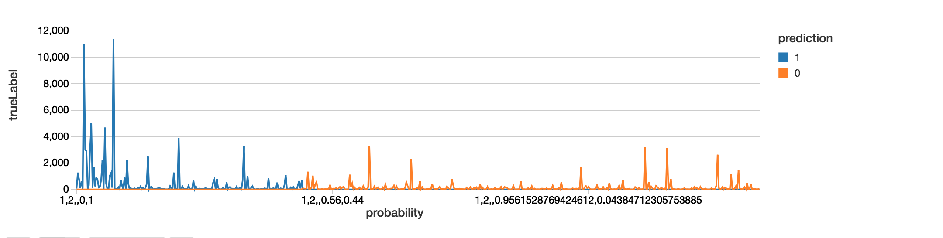
DATABRICKS MODEL #1: Decision Tree Classifier
TrueLabel and Prediction

Slide 25
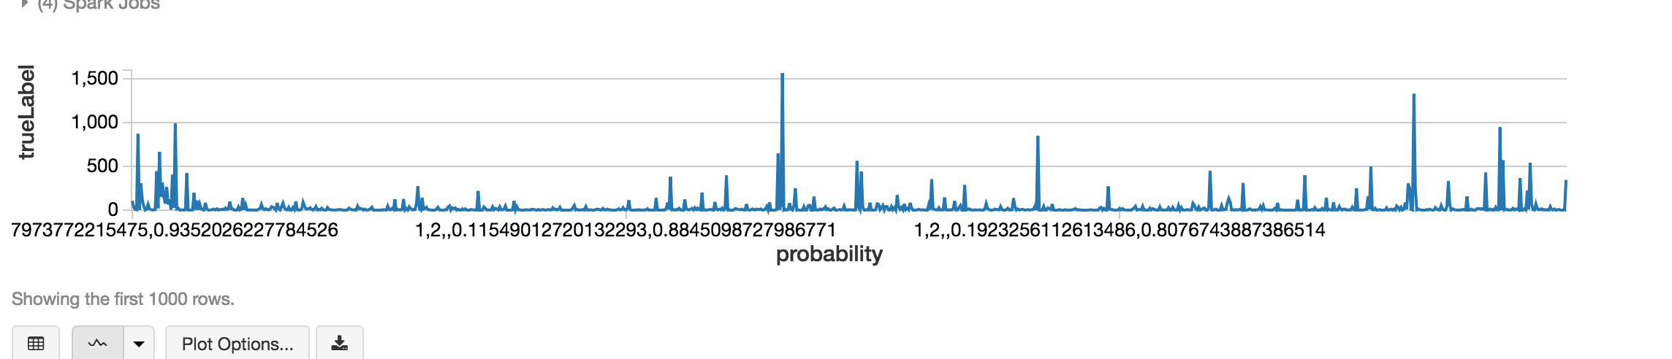
DATABRICKS MODEL #2: Random Forest Classifier
TrueLabel and Prediction

Slide 26
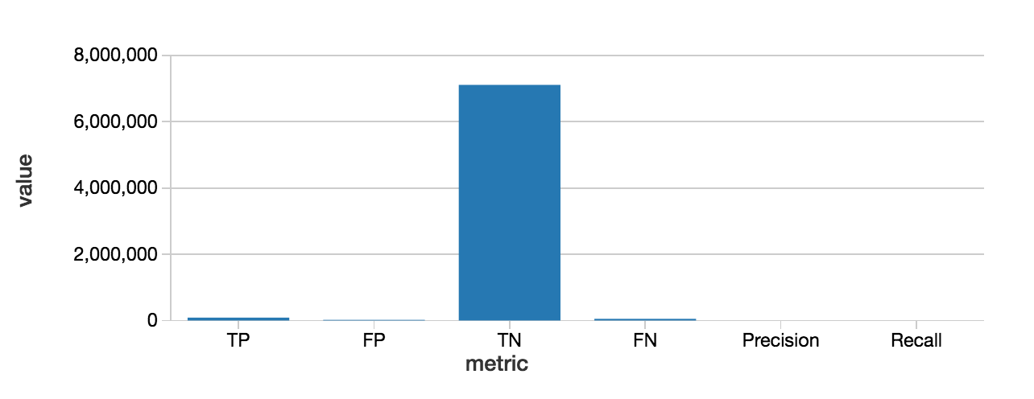
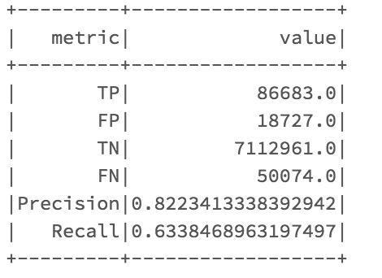
DATABRICKS MODEL #1: Decision Tree Classifier
Confusion Matrix

Slide 27
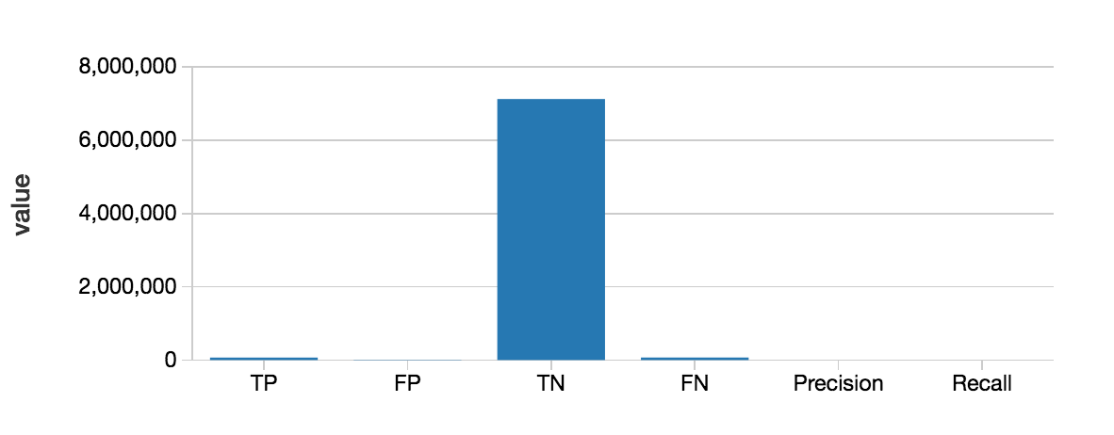
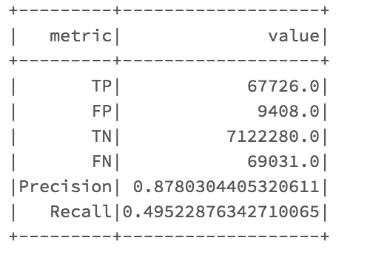
DATABRICKS MODEL #2: Random Forest Classifier
Confusion Matrix

Slide 28
DATABRICKS SPARK ML RESULTS COMPARISON
 | Decision Tree Classifier | Random Forest Classifier
AUC | 0.815 | 0.746
PRECISION | 0.822 | 0.878
RECALL | 0.633 | 0.495
TP | 86,683 | 67,726
FP | 18,727 | 9,408
TN | 7,112,961 | 7,122,280
FN | 50,074 | 69,031
RMSE | 0.0972 | 0.1038
Decision Tree Classifier is the best model!

Slide 29
AZURE ML AND DATABRICKS RESULTS COMPARISON
 | TWO-CLASS DECISION JUNGLE | TWO-CLASS DECISION FOREST | DECISION TREE CLASSIFIER | RANDOM FOREST CLASSIFIER
AUC | 0.905 | 0.997 | 0.815 | 0.746
PRECISION | 1.0 | 0.992 | 0.822 | 0.878
RECALL | 0.001 | 0.902 | 0.633 | 0.495
TP | 35 | 47,199 | 86,683 | 67,726
FP | 0 | 377 | 18,727 | 9,408
TN | 52,306 | 406,228 | 7,112,961 | 7,122,280
FN | 406,605 | 5,142 | 50,074 | 69,031
Run Time | 2 hrs | 2-3 hrs | 22 mins | 50 mins
Azure ML Two-class Decision Forest is the best model!

Slide 30
REFERENCES
Github link: https://github.com/ngupta8
https://www.kaggle.com/c/talkingdata-adtracking-fraud-detection/data
https://blogs.msdn.microsoft.com/andreasderuiter/2015/02/09/performance-measures-in-azure-ml-accuracy-precision-recall-and-f1-score/
https://docs.microsoft.com/en-us/azure/machine-learning/studio/
https://docs.microsoft.com/en-us/azure/machine-learning/studio/algorithm-choice
https://docs.databricks.com/spark/latest/mllib/binary-classification-mllib-pipelines.html

Slide 31
THANK YOU!

